Slide 1

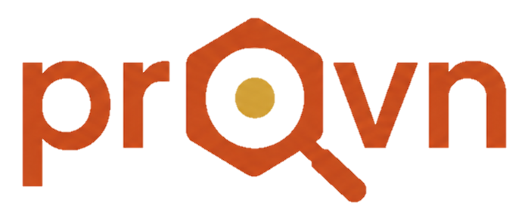

INVESTOR PITCH · CAIRO, EGYPT · 2026
No More Asking Around for Technicians.
A technician marketplace built on referrals, verification, and real customer reputation.
REFERRAL-LED · VERIFIED · REPUTATION-BUILT
Notes:
- Open with the universal Egyptian pain: every household asks around for a technician.
- Why now: smartphone penetration, distrust of informal referrals, and rising service expectations have hit a tipping point.
- This deck walks through problem, solution, model, market, moat, team, and the ask.
- Tease the ask: raising a round to formalize Egypt's technician economy, starting in Cairo.
- Image cue: a verified technician at work — this is the work Provn makes searchable.

Slide 2
02 / 12
THE PROBLEM
Finding A Reliable Technician In Egypt is broken
Finding a technician still depends heavily on word-of-mouth, informal communication, and luck.
MULTIPLE
(4.7%)
CONVERSATIONS TO FIND ONE
Friends, relatives, and neighbors — until someone knows a technician.
(4.7%)
NO
(15.6%)
SHARED TRUST RECORD
The recommendation lives inside one person's network — not a shared, searchable record.
ONE
AVERAGE HIDES DETAIL
(76.6%)
Speed, quality, and behavior can tell very different stories.
Notes:
- Universal Egyptian experience — everyone has wasted hours chasing a guy who knows a guy.
- Real cost of the broken system: damage compounds while you wait, and no one is accountable.
- "0 guarantee" is the wedge — verification is what no informal channel can offer.
- Sets up the solution: trust formalized, made searchable.
- Image cue: a burst pipe — visceral, on-message, this is the moment customers have zero time and zero guarantee.

Slide 3

03 / 12
THE SOLUTION
Provn Turns Word-Of-Mouth Into a Verified Network
Technicians are referred by people who know them, verified before they go live, then build reputation through real customer interactions.
REFERRED
VERIFIED
RATED ON 3 AXES
Notes:
- One-line pitch: Provn turns word-of-mouth into a verified network.
- Inversion vs typical marketplaces — supply is gated, not demand.
- Three gates every technician passes: referred, verified, rated on three axes.
- Image cue: a skilled electrician doing the work — this is what verification makes findable.
- Bridge to next slide: here's how the three-gate system actually works.

Slide 4
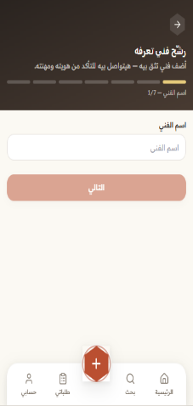
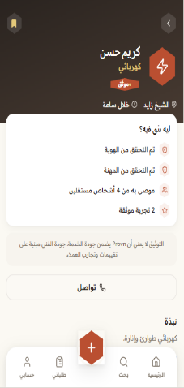
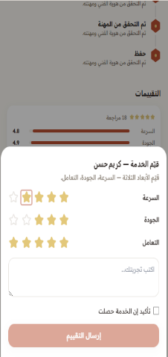




04 / 12
HOW IT WORKS
Trust First, Search Second
PRODUCT DEMO
Trust is built in layers — before and after a technician goes live.
Refer
A trusted person recommends a technician they already know.
NO REFERRAL · NO PROFILE
Verify
Provn confirms identity, trade, and the technician's consent.
IDENTITY · TRADE · CONSENT
Rate
3
Real customers rate on Speed, Quality, and Behavior.
01REFER
02VERIFY
03RATE
SPEED · QUALITY · BEHAVIOR
✦
The Hunter Loop: Referrers earn points when their referral leads to a verified technician and a completed service.
SCAN TO TRY PROVN
Live prototype · provn.base44.app

Slide 5
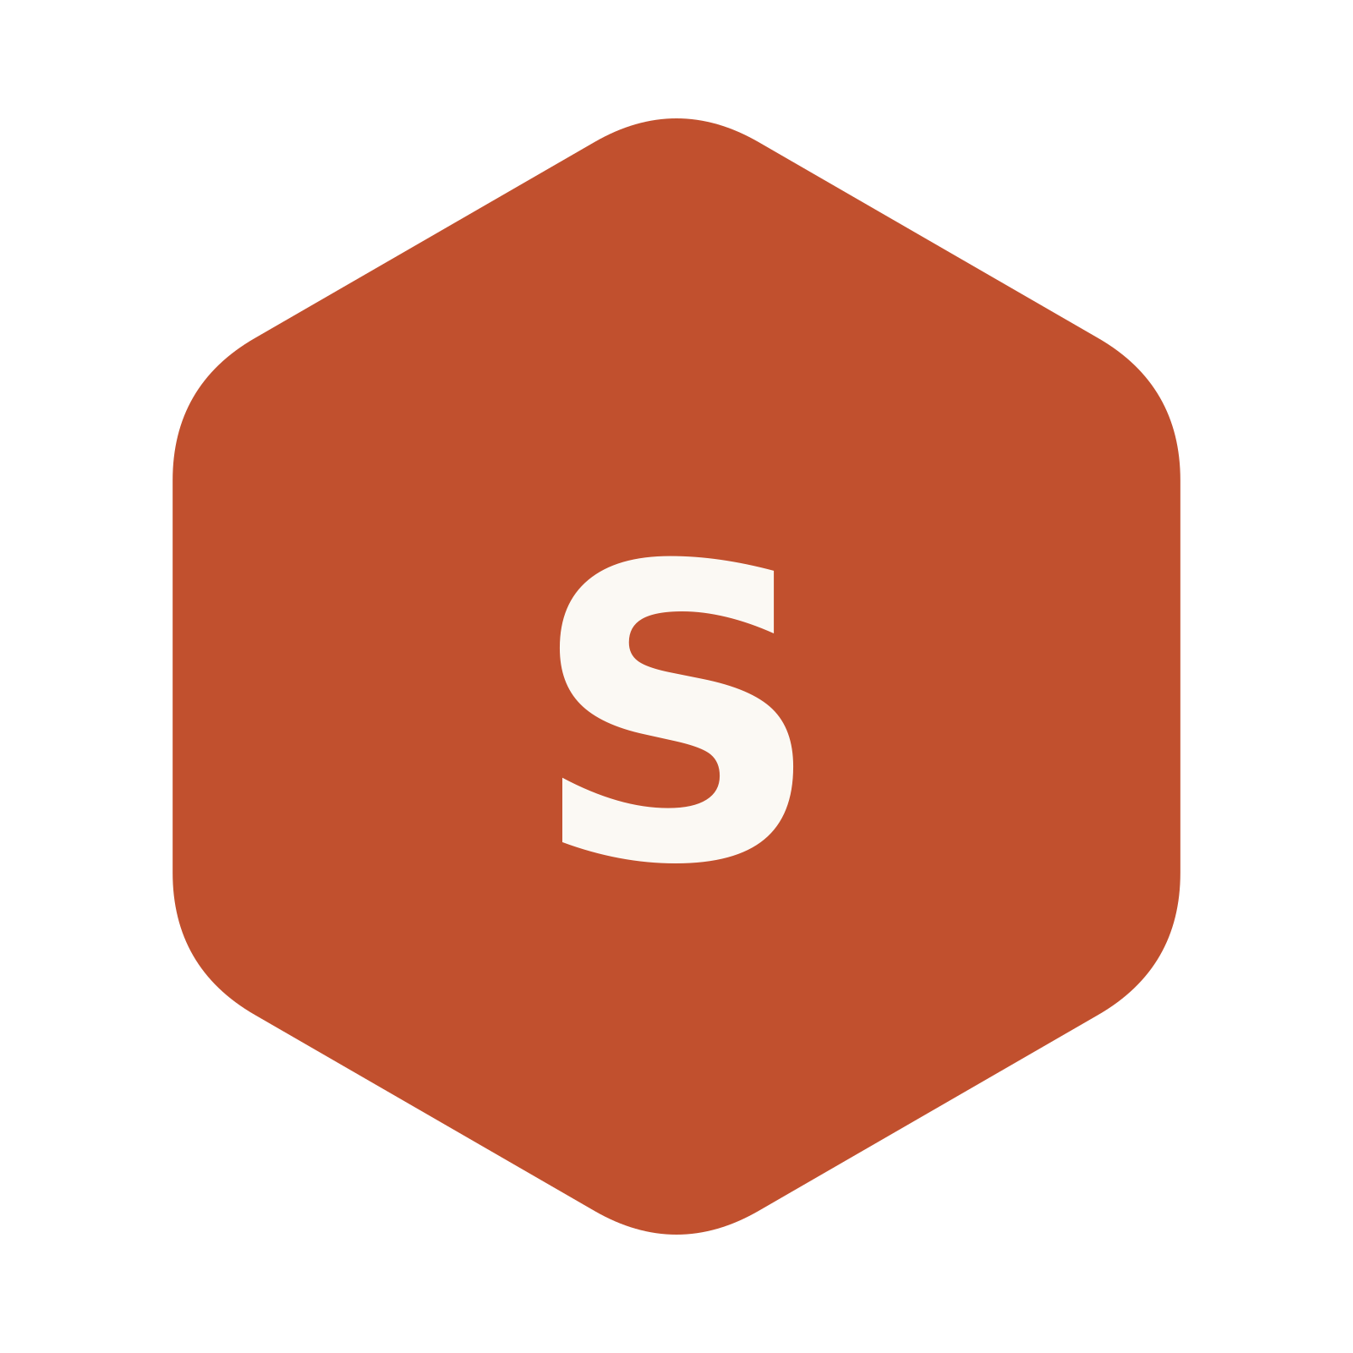

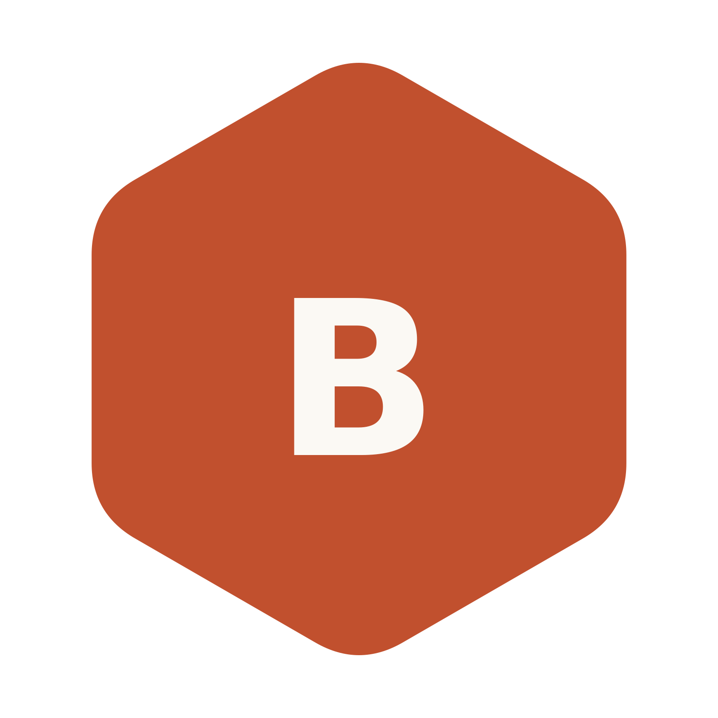
05 / 12
WHY THREE AXES
One Star Isn’t Enough
One average score can hide very different customer experiences.
SPEED
QUALITY
BEHAVIOR
Did they show up when they said?
Did the work actually fix it?
Were they respectful in your home?
Durability, cleanliness, recurrence.
Response, punctuality, turnaround.
Courtesy, communication, care for the space.
Notes:
- Average rating hides everything — a 4.8 could mean fast-but-rude or careful-but-slow
- Behavior is the most underserved axis across the entire gig economy, not just Egypt
- Three axes become a data moat: we learn what customers actually reward over time
- Changes customer choice: pick speed for emergencies, quality for big jobs, behavior for home visits

Slide 6

06 / 12
Why Provn Wins
Trust Starts Before The Search
Anyone can build a directory. What they cannot copy is a network of vouched-for relationships — rebuilt one customer at a time.
Referral-first network
Hunters grow the network
Technicians enter through people
who already know
People are incentivized to bring trusted technicians into Provn.
Reputation that compounds
Local trust density
Every real service interaction
strengthens a technician’s
reputation.
As the network grows locally,
trusted supply becomes
easier to find.
Reputation compounds with every confirmed job.
Notes:
- The moat is a graph, not a feature — competitors can clone the app, not the relationships.
- Contrast with self-register marketplaces: those reward supply volume, not supply trust.
- Four pillars: gated intake, three-axis data, district density, compounding reputation.
- Image cue: dense Cairo rooftops — the urban trust network we are formalizing, district by district.
- Early lead in every district compounds — each verified job strengthens the graph.

Slide 7
07 / 12
MARKET OPPORTUNITY
A Market Hiding In Plain Sight
Egypt’s home-services market is still heavily driven by word-of-mouth and informal communication. Provn is built to formalize that trust layer at scale.
118M+
43%
POPULATION · 2025
URBAN POPULATION · 2023
Egypt is the largest Arab country by population.
A large urban customer base.
$1.88B
FRAGMENTED
HOME SERVICES MARKET · 2025
MARKET STRUCTURE
Deep Market Insights estimate
Trust is still fragmented across personal networks and informal channels.
Sources: UNData (population, 2025); UNICEF Egypt (urban share, 2023); Deep Market Insights (home services, 2025).
Notes:
- Scale: 100M+ population — biggest Arab market, mostly underserved by digital platforms
- Why now: smartphone, digital payments, and urban density all hit inflection in the last 24 months
- White space: under 5% formalization means we’re creating the category, not fighting incumbents
- Geographic concentration: Cairo + Alexandria capture most of GDP, easier to seed network density

Slide 8
08 / 12
GO-TO-MARKET
Cairo First, Density Before Breadth
Provn wins one neighborhood at a time. Supply density creates demand reliability — then we move cities.
DENSITY → RELIABILITY → REPLICATION
PHASE 01
PHASE 02
PHASE 03
3 Cairo Districts
Greater Cairo
Expansion Cities
Maadi, Helwan, Nasr City. Build verified supply before opening demand.
Replicate the playbook across the metro and open B2B with property managers.
Take the proven playbook to Alexandria and the next priority city.
FOCUS: DENSITY
FOCUS: B2B ANCHOR
FOCUS: REPLICABLE
Notes:
- District density beats national sprawl — we win one neighborhood fully before opening the next.
- Phase 1 anchors three Cairo districts; supply is verified before demand opens.
- Phase 2 layers in B2B elite contracts with property managers as the revenue anchor.
- Phase 3 takes the proven playbook to Alexandria and Giza at smaller radius.

Slide 9
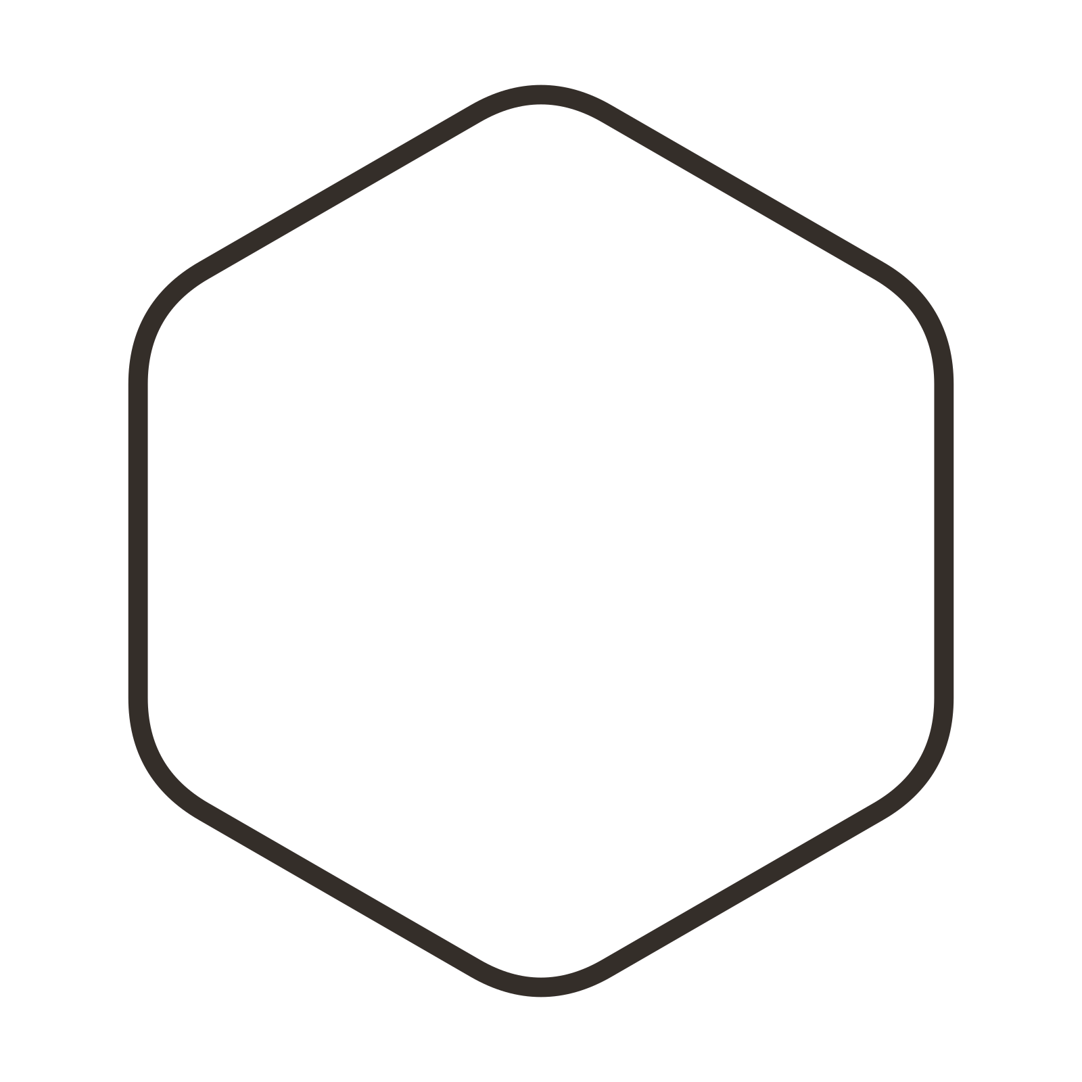


09 / 12
BUSINESS MODEL
Three Streams, One Engine
Three revenue streams. advertising first; emergency service follows; B2B comes later as density grows.
PRIMARY
GROWTH
LATER
Advertising
Premium Emergency Tier
B2B Elite Contracts
Clearly labeled placements for complementary tool and supply businesses
Premium urgent jobs from the contracted Elite technician pool, with defined availability windows.
Vetted technicians contracted to property managers and FM firms. Recurring monthly revenue per contract.
SCALE-DEPENDENT
TRANSACTIONAL · PREMIUM
RECURRING · CONTRACTED
Notes:
- B2B Elite Contracts are the anchor — predictable, recurring, high LTV.
- Emergency tier drives margin and brand visibility today.
- Advertising is intentionally last — only switch on at defensible density.
- Density improves unit economics across all three streams.
- One engine: every job strengthens the trust graph that powers all three.

Slide 10
10 / 12
THE NEXT STEP
Turn The Prototype Into Proof
Prove the Cairo loop before expanding it.
STEP 03
STEP 02
PROVE B2B
PROVE THE LOOP
Elite contracts with property managers.
Reliable demand, real service interactions, and reputation.
STEP 01
BUILD TRUSTED SUPPLY
Verified technicians across the first Cairo districts.
THE OUTCOME
Trusted supply → reliable demand → repeatable Cairo playbook
Then repeat the playbook.
Notes:
- Five dedicated owners, each with a clear lane — no overlap, no gaps.
- The Q&A research lead ensures no surprise questions in the room.
- Each owner can answer domain-specific questions live without passing the buck.
- Compact structure designed to scale — owners become functional leads post-raise.

Slide 11
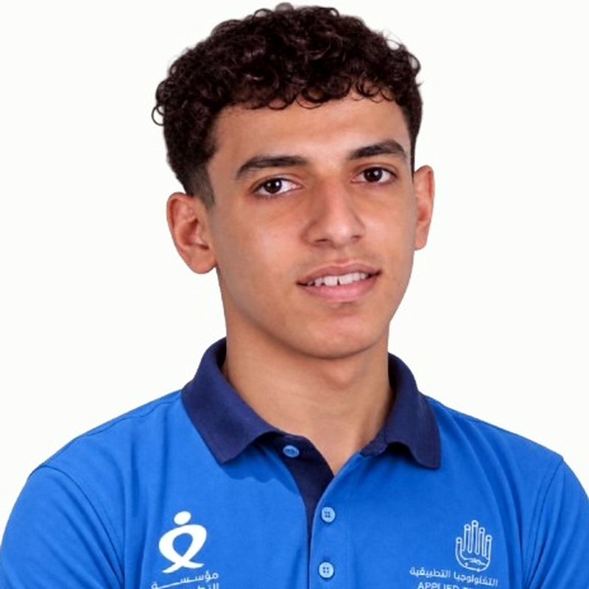
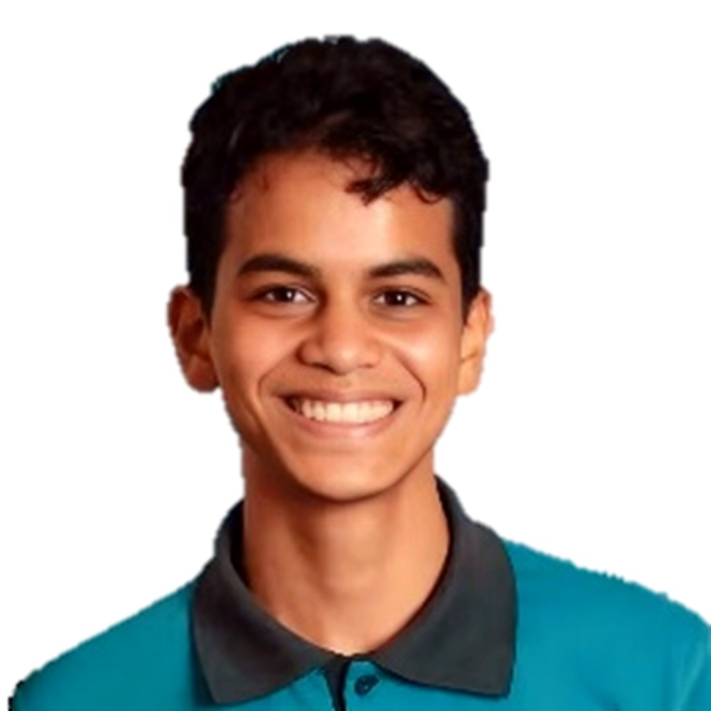
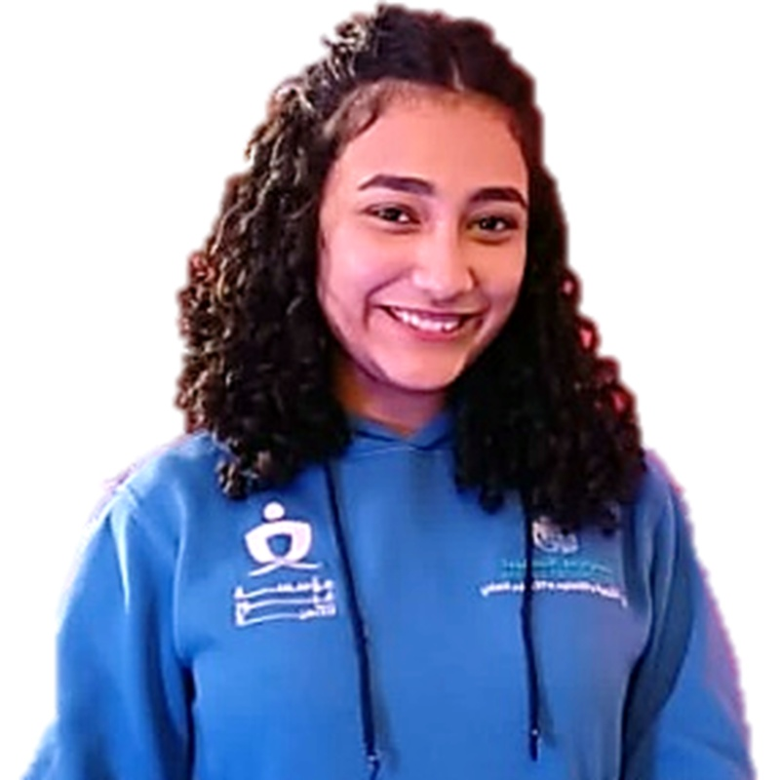
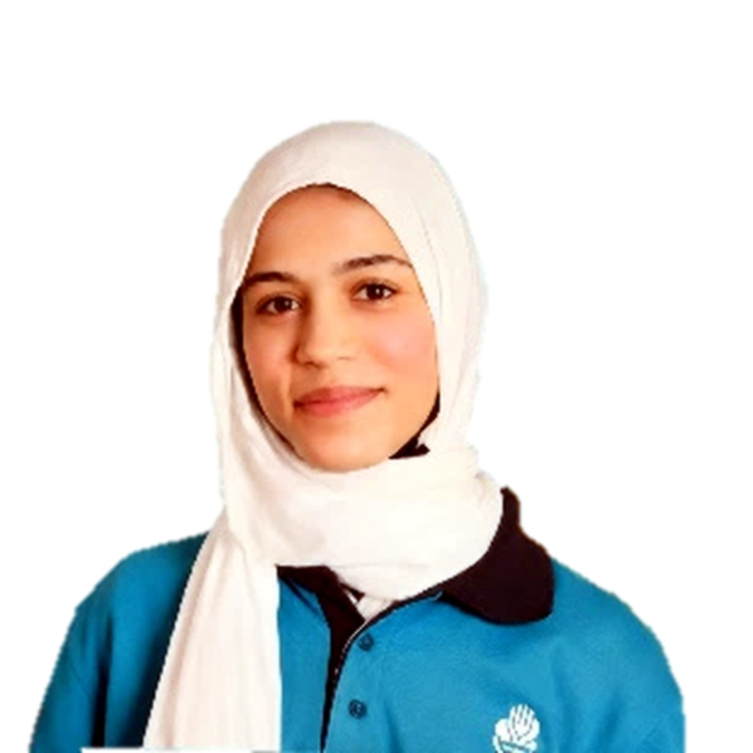
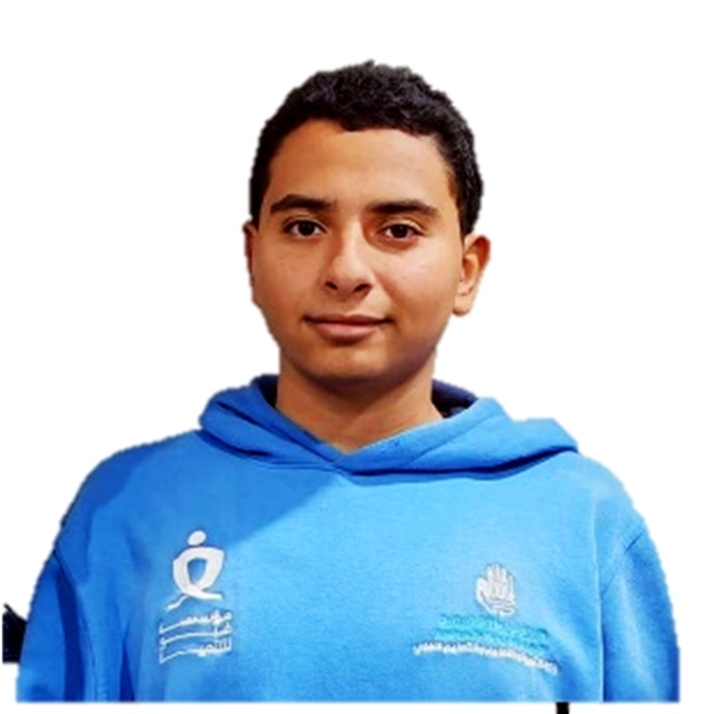
11 / 12
TEAM
Five Owners, One Mission.
Each pillar has a dedicated owner who can answer any question in their domain.
BELAL TAMER
MAZEN IBRAHIM
MUHRAIEL EMAD
HABIBA ALI
ABDELRAHMAN MAMDOUH
FINANCIAL MODEL
& STRATEGY
FOUNDER
&TEAM LEADER
VISUAL IDENTITY
& DESIGN
CONTENT & MARKETING
RESEARCH & Q&A PREP
BMC, revenue model, and unit economics.
Product flows, verification, wallet, and technical logic.
Brand, deck, and product design.
Messaging, website copy, and pitch narrative.
Competitor research, Q&A, and assumption testing.
Notes:
- Five dedicated owners, each with a clear lane — no overlap, no gaps.
- The Q&A research lead ensures no surprise questions in the room.
- Each owner can answer domain-specific questions live without passing the buck.
- Compact structure designed to scale — owners become functional leads post-raise.

Slide 12
No More Asking Around for
Technicians.
A technician marketplace built from referrals, verification, and real customer reputation.
Let's build Egypt's trusted technician network.
CAIRO, EGYPT · PROVN · INVESTOR DECK 2026
Notes:
- Restate the tagline: no more asking around for technicians.
- One-sentence summary: a verified technician marketplace built on existing trust.
- The ask unlocks verified density in target districts.
- Invite the next conversation — happy to share data room and team intros.
- Thank the room and acknowledge the operators who fed the insight.

